Slide 1
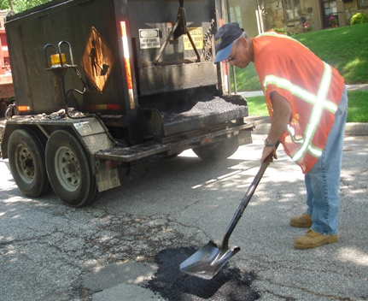

CSSE 579: Session 9, Part 1
Software Maintenance and Project Management
Above – Software is not the only place where users are sensitive to the quality of maintenance. How about those Indiana roads? From http://www.city.west-lafayette.in.us/department/division.php?fDD=10-62.
Steve Chenoweth
Office Phone: (812) 877-8974
Cell: (937) 657-3885
Email: chenowet@rose-hulman.edu

Slide 2
This week
This week’s new topics –
  Maintenance and Project Management – this slide set
  Metrics and measurement, including EVM – the second slide set
  Critical Chain – the third slide set
  Agile Release Management and Risk Management – the fourth slide set
The usual questions, this time on teamwork in your world.
Next week’s (Week 10) topics – “Ethics and Trends”
  Advanced topics & new trends – including technical debt (reading this week)
  Planning for continuous integration and automation
  Ethical decision making
Third exam is already out on the web site! Due Monday, May 25 (hard deadline).

Slide 3
This slide set
Maintenance and project management! –
What’s different about maintenance?
What are the goals, from a PM perspective?
What are the organizational options?
The article you read – Case study: What are the critical issues and success factors of maintenance?
What does Donald Reifer have to add?

Slide 4
What are “Maintenance” topics?
Maintenance is a subset of “evolution”
Emphasizes what has to be changed –
  As time goes on after initial development
  Especially from the developer’s perspective
And issues with that
  And approaches to resolving those
Lots about bug fixes and minor enhancements
Evolution as a whole, in contrast –
Studies how things are done generally
  Like different approaches in different vocational areas, and
  The overall “laws of evolution” in effect
  E.g., studies of system decay over time
Lots about adaptation and migration, which is useful for activities like planning product strategies and major releases.
A practitioner’s view
A manager’s /
theoretician’s view

Slide 5
General Maintenance Themes
Need to be self-aware while doing it
Need to be systematic
Need to document
  E.g., How long did it take to make that fix?
Experiment – try alternative approaches
  What should we try next time?
Tune and retune based on what’s learned
  Amount of tuning is based on maturity with product, processes and tools

Slide 6
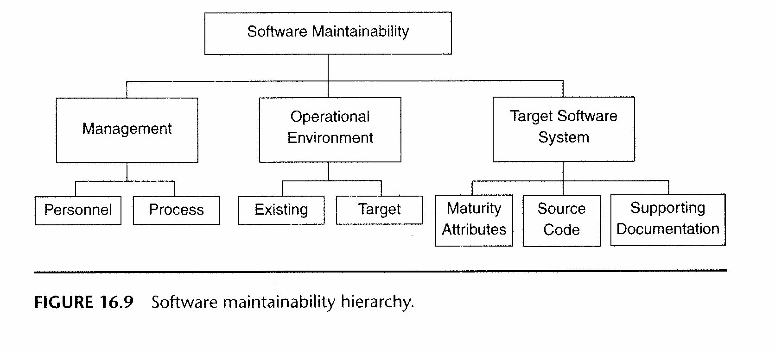
Goal = high “maintainability”
Best practices are learned in each of the areas pictured.
  In source code, for example, it involves things like:
    Localizing changes
    Preventing ripple effects
    Deferring binding time
We’ll discuss how to achieve this, in next slide set.
Notes:
From Thomas M. Pigoski, “Practical Software Maintenance,” p. 288.

Slide 7
Setting up maintenance processes
Done as part of product planning
  Not at end of initial development
  Maintenance is not a “post-delivery activity”
Need a “Maintenance plan”
  Includes a “transition plan” to maintenance group (or mixed activities by a single group)
  Need to decide who does maintenance – see next two slides
  Transition to maintenance is painful, no matter how it’s done

Slide 8

Software start-up horror story
Hey boss, we finally shipped, so we’re ready to dive right into Release 2!
Who are you kidding? The customer just called…You can’t do anything else till you fix all those new bugs!
The payoff for two years of 80-hour weeks…
Notes:
Image from http://insidetv.ew.com/2013/10/17/american-horror-story-ryan-murphy-boy-parts/.

Slide 9
Same team does maintenance?
Advantages:
  Transition plan is simpler –
    No personnel changes
  Developer has the best knowledge
  Don’t need formal communication to maintainers
  Separate maintenance organization has its own priorities
  No need to decide “who goes where” at end of initial development
  Less need for training /expertise transfer
  Residual developers would still need to help separate maintainers
  Already know product tools

Slide 10
Different team does maintenance?
Advantages:
  Maintenance group tends to do better processes
  Not distracted by upcoming major releases or new products
    Developers can do these (usually)
  Understand metrics for maintenance

Slide 11
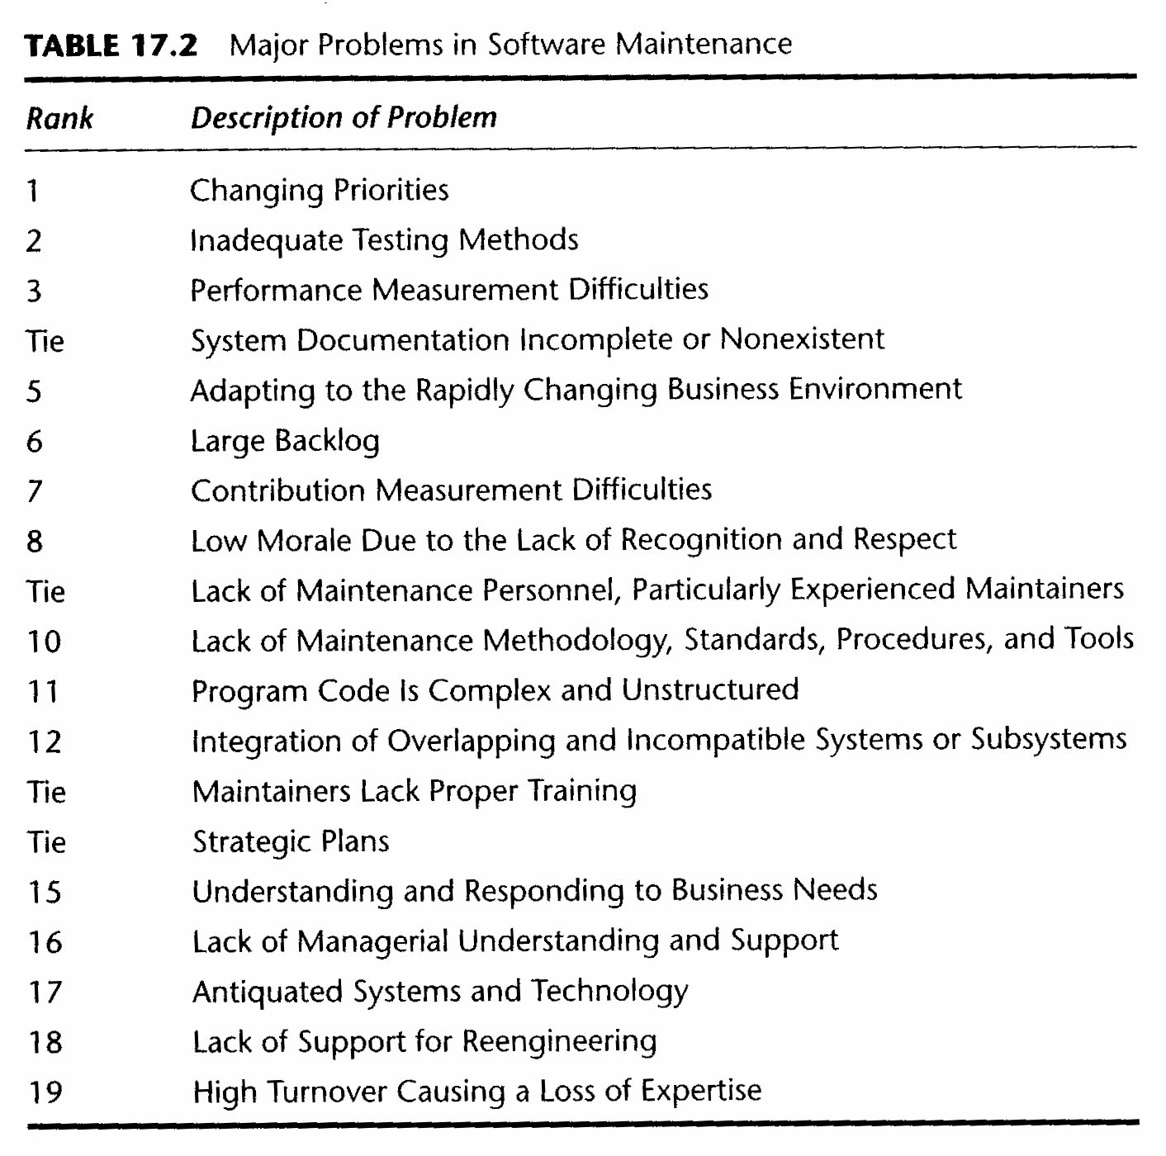
Maintenance Issues
Notes:
From Thomas M. Pigoski, “Practical Software Maintenance,” p. 295.

Slide 12
Conceptual issues
Maintenance relies on all prior work.
Documentation and the system get more complex.
Difficult to track changes.
Ripple effects.
Personnel / knowledge loss over time.

Slide 13

The case history you read
Sneed & Brossler, “Critical Success Factors in Software Maintenance: A Case Study,” 2003
Goal –
  Apply known 8 factors to a large project
  Evaluate in importance for current project
“Success” traditionally ==
  Increase in user satisfaction
  Reductions in costs
Harry M. Sneed,
2003
Notes:
Image from http://www.anecon.com/experten/expertenfruehstuecke/15-anecon-expertenfruehstueck/vortragende-des-15-expertenfruehstuecks.html.

Slide 14

Case history, cntd
Authors proposed instead, Success is in terms of:
  Functionality
  Quality
  Complexity
  Volatility
  Costs
  Release deadlines
  User satisfaction
  Profitability
A volatile couch, in action.
Notes:
Image from http://www.jinbiban.com/extraordinary-fashionable-highly-versatile-sofa-for-an-interior-constantly-changing-its-appearance-galleries-top-resolutions/

Slide 15

The authors’ advice:
Preserve functionality.
Preserve quality.
Don’t increase complexity.
Don’t make the product volatile.
Don’t increase costs.
Keep deadlines.
Maintain user satisfaction.
Don’t lose money.
Notes:
Image from http://www.protradingnow.com/2014/04/03/hey-trader-i-know-why-you-are-losing-money/

Slide 16
Case history, cntd
Authors then measured each of these 8 factors, for the target system:
  They saw success on the first six
  The last two – inconclusive
    Partly, the system was now technologically outdated
The target system was a securities-trading banking system.
  Needed to become web based!

Slide 17

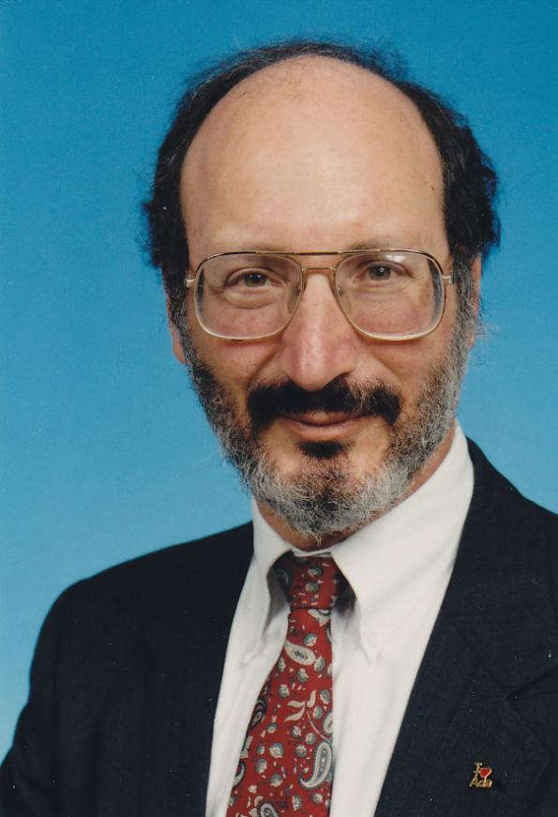
Donald Reifer’s Perspective
From his 2012 book, Software Maintenance Success Recipes. CRC Press, ISBN 978-1-4398-5166-1.
Maintenance is not a tack-on to development.
Development is the start of maintenance.
Notes:
Current image of Reifer is from https://www.thecsiac.com/author/donald-j-reifer.

Slide 18
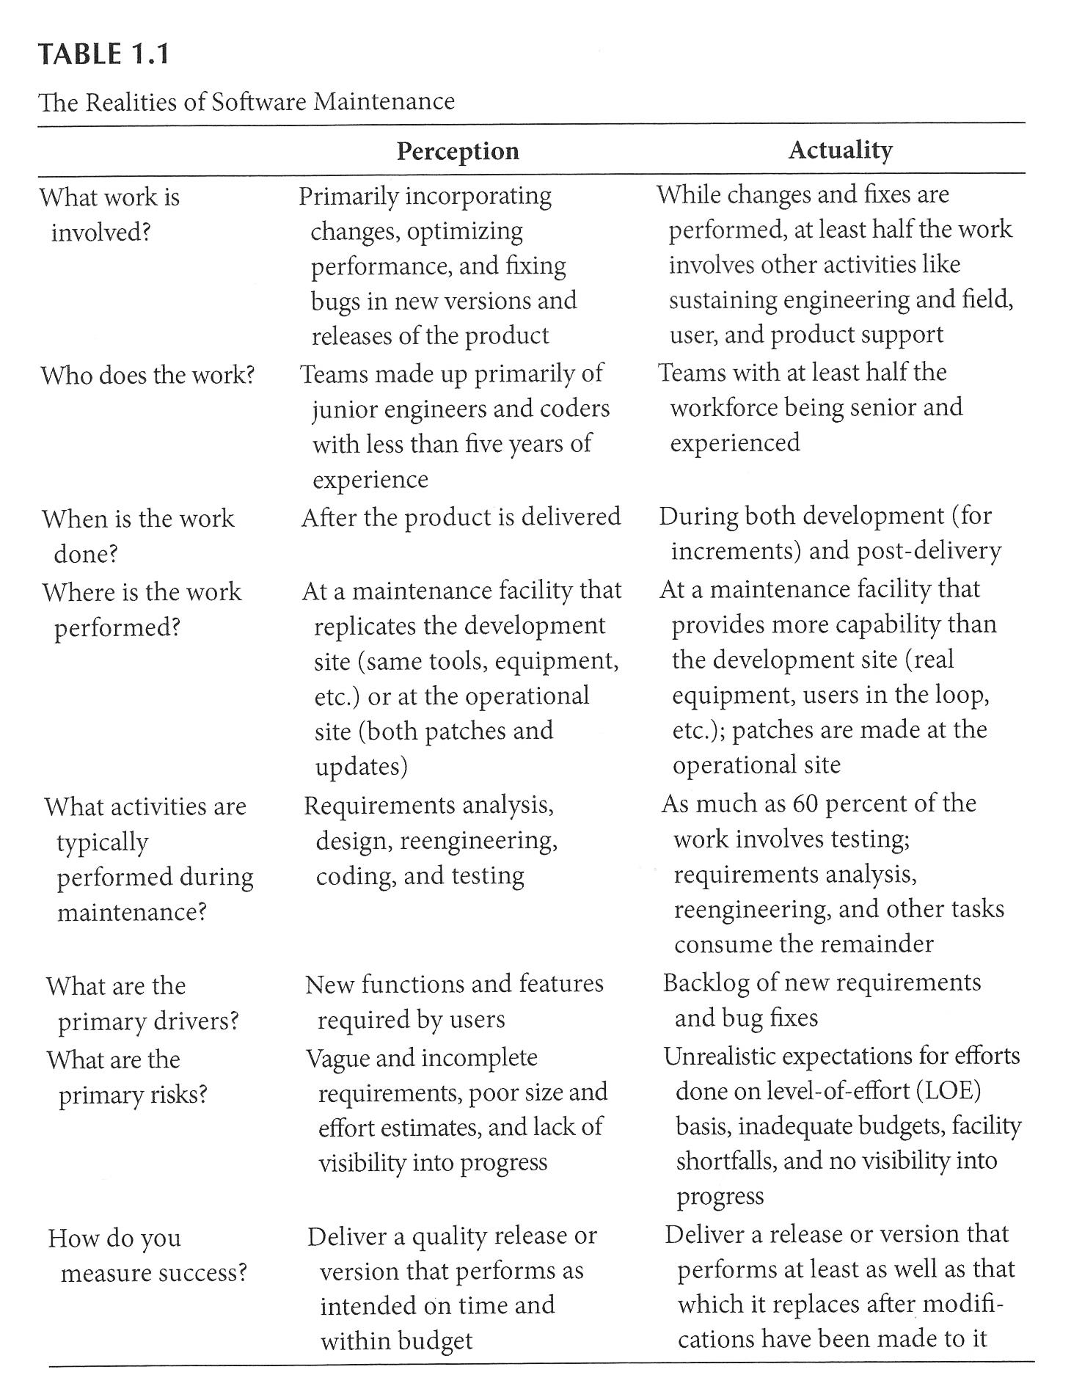

Conclusion…
Realities…
Our current perceptions don’t match the actualities of maintenance
Notes:
Socks from http://www.yourdictionary.com/mismatch.

Slide 19
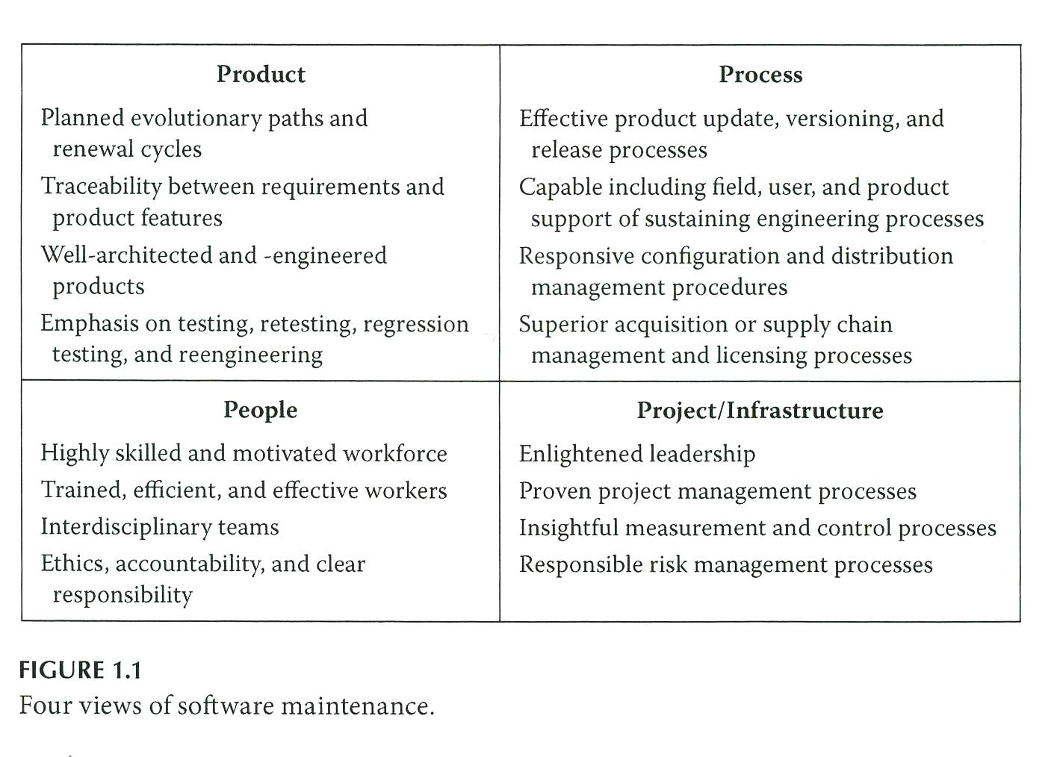
What’s important?
What do you think of first, when you think of software maintenance activity?

Slide 20
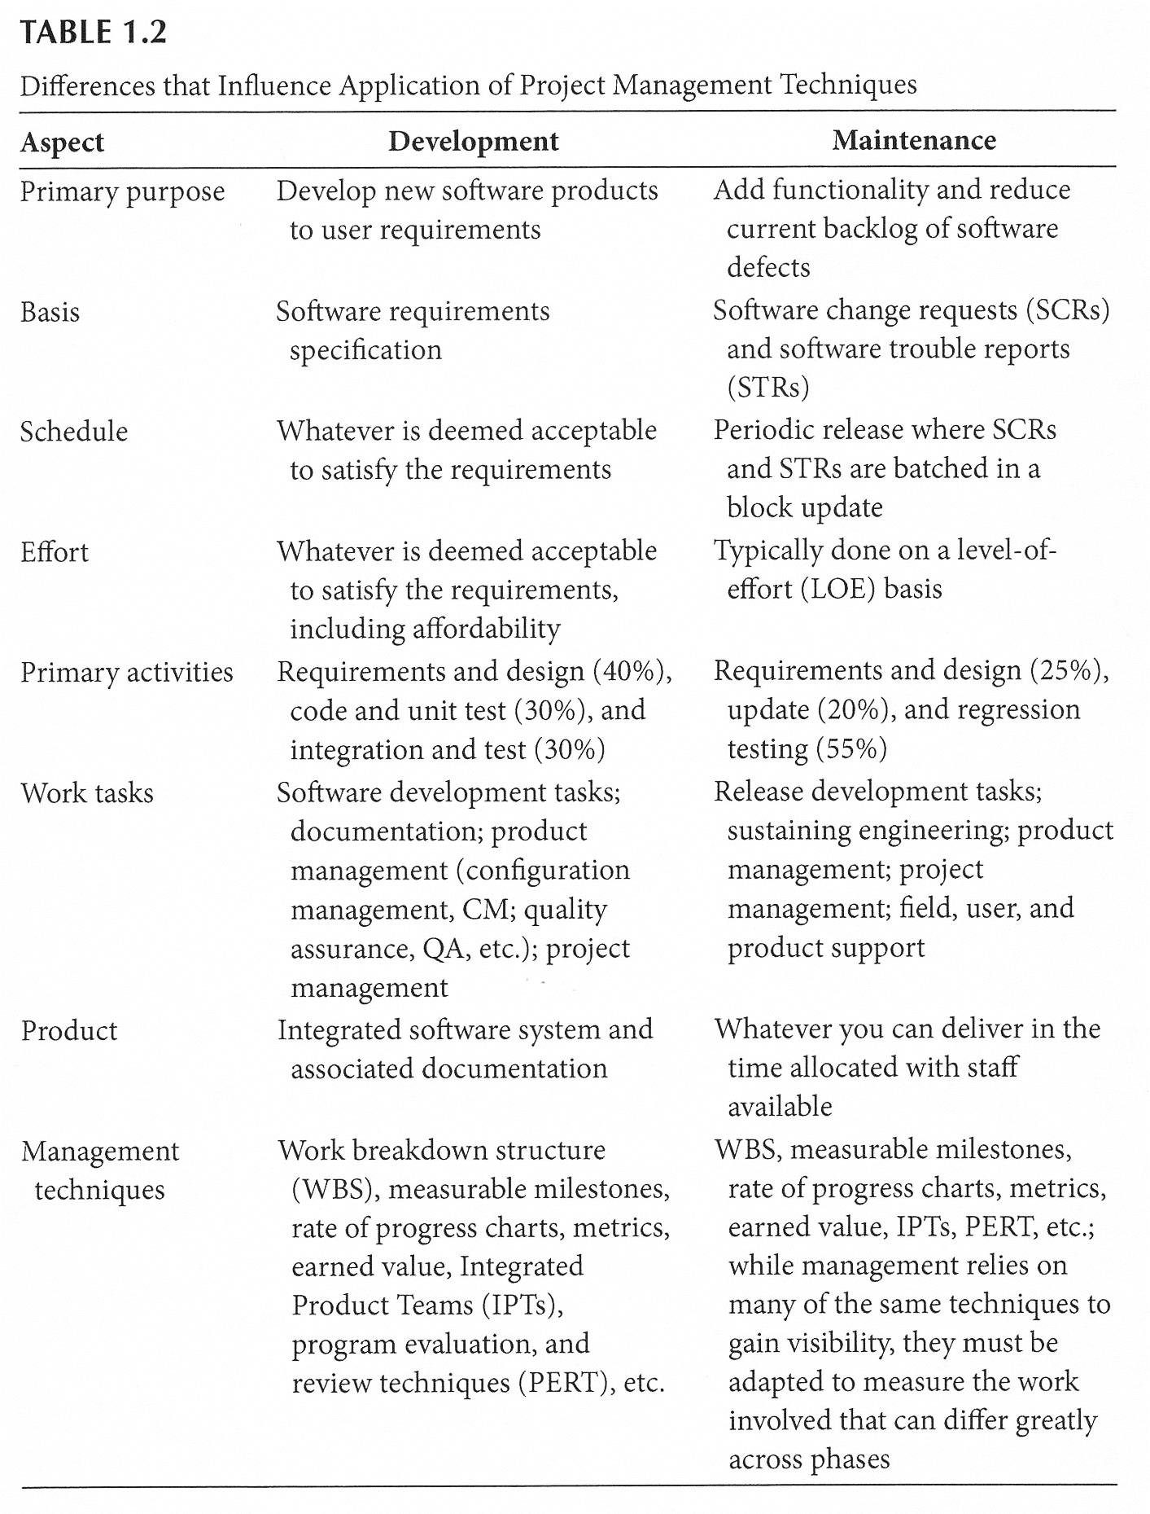
What influences maintenance actions?
Depends…
But it differs from development!

Slide 21
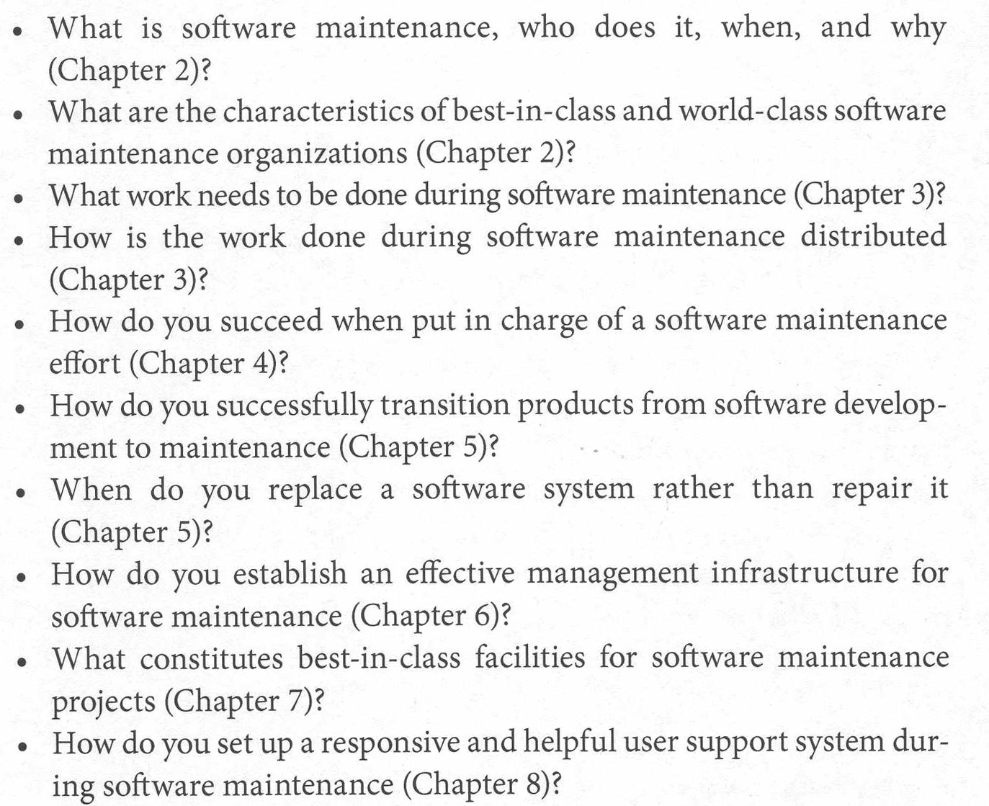
What else is in Reifer’s book?

Slide 22
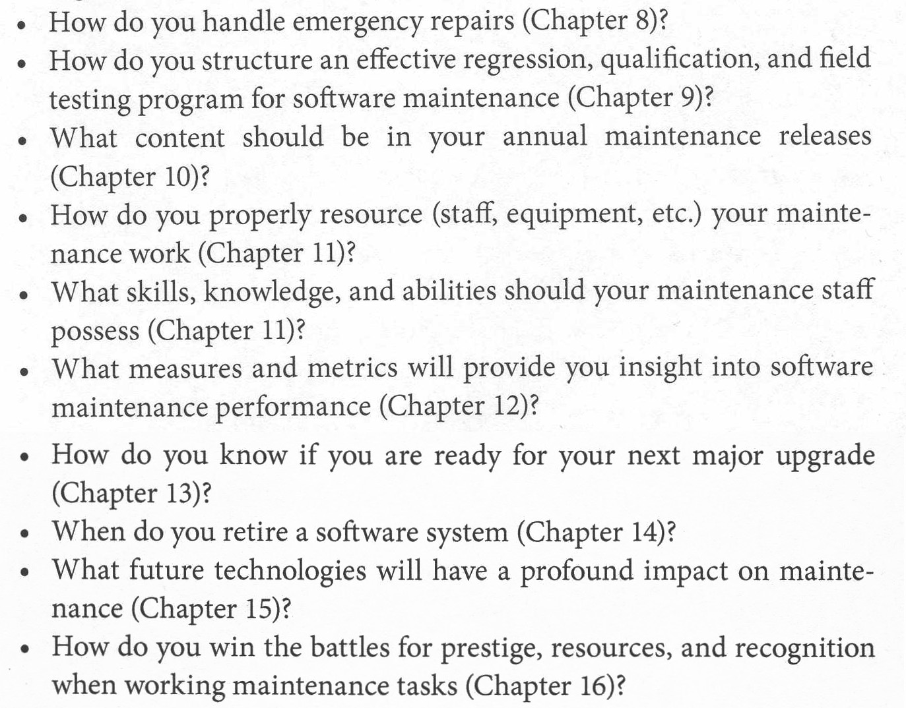
Or…

